Slide 1

C Developer
Functions

Slide 2

Course Objectives
Know how to declare a function
Understand how to simulate a procedure
Develop good programming habits by breaking down projects

Slide 3

Course Plan
1. Function Declaration
2. Splitting a Program into Modules
3. Function Parameters

Slide 4

1. Function Declaration

Slide 5

1. Function Declaration
Definition of a function
A function is basically a subroutine that takes parameters as input and returns a value
There are no procedures in C; however, we will see how to simulate a procedure using functions that do not return any value, and how to modify the value of the parameters using pointers
By being able to modify the value of the parameters, we will no longer be limited to input parameters, and we will be able to have output parameters or input/output parameters

Slide 6
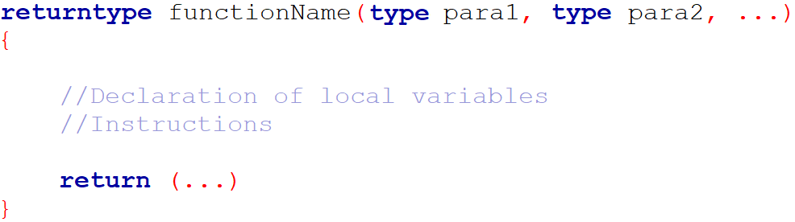
1. Function Declaration
Definition of a function
Syntax:

Slide 7
1. Function Declaration
Definition of a function
We call a function by specifying its name, and between parentheses the values we want to assign to the parameters
The value returned by the function will either be assigned to a variable or displayed

Slide 8
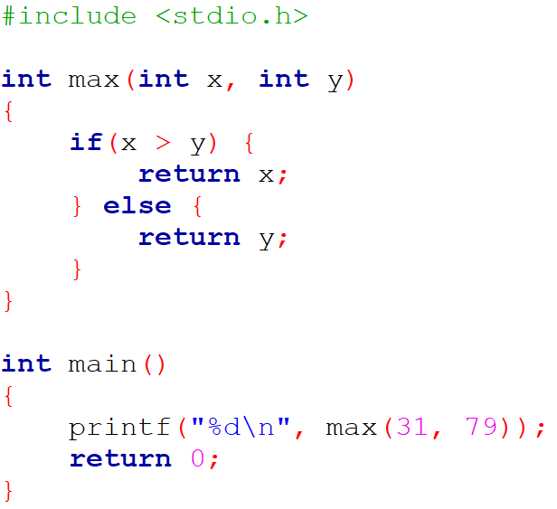

1. Function Declaration
Definition of a function

Slide 9
1. Function Declaration
Definition of a function
If the function we want to create is not intended to return a value, we replace its return type by the void keyword
The function will of course not contain the return command
This thus simulates a procedure performing an action

Slide 10
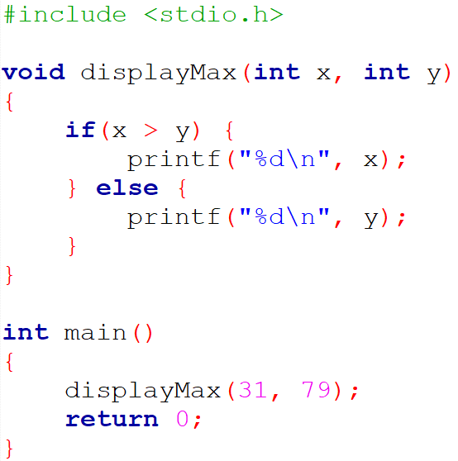
1. Function Declaration
Definition of a function

Slide 11
1. Function Declaration
Definition of a function
It is possible to write functions that take no parameters as input: to indicate this, the declaration of parameters is replaced by the void keyword
The function call will then simply be without content between the parentheses

Slide 12
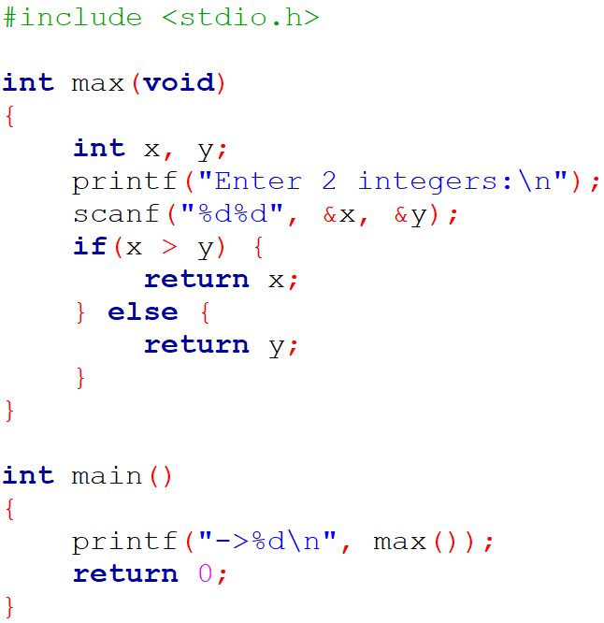
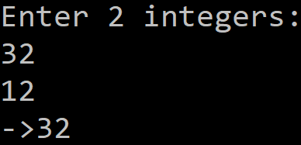
1. Function Declaration
Definition of a function

Slide 13
1. Function Declaration
Function prototype
It is a simple line indicating the type returned by the function and the types of the parameters:
It will be used to declare the functions, before implementing them: this will increase the code readability

Slide 14
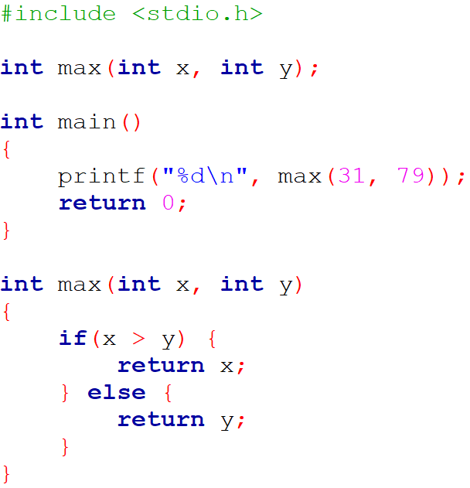
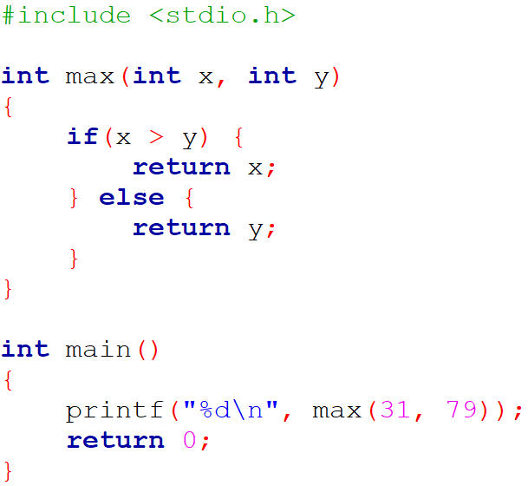
1. Function Declaration
Function prototype

Slide 15
1. Function Declaration
Function prototype
In such a simple case, the benefit is not obvious
In a program with a lot of functions, it is better to do so
The main appears first, which makes the code easier to read
It also and especially allows to define functions locally

Slide 16
1. Function Declaration
Global or local declaration
For now, our function declarations are done before the main, in other words, in a global way
This means that our functions were usable everywhere in the program, whether in main or in another function

Slide 17
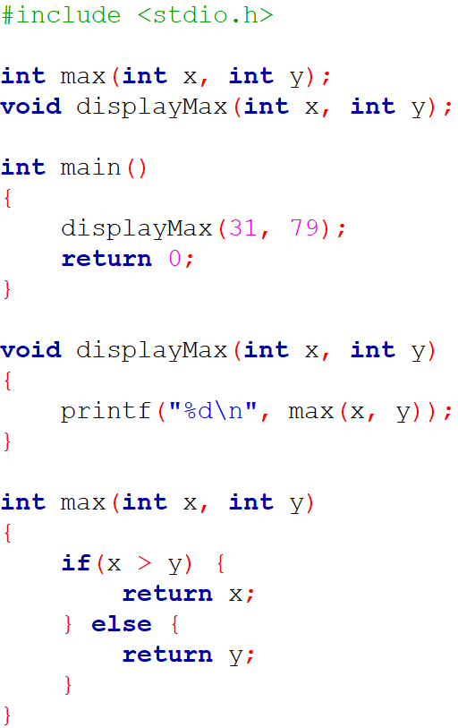
1. Function Declaration
Global or local declaration

Slide 18
1. Function Declaration
Global or local declaration
In this example, only the displayMax function uses the max function
It therefore seems natural to define the max function only in the displayMax function
We thus make a local declaration of max, which can then only be used in displayMax

Slide 19
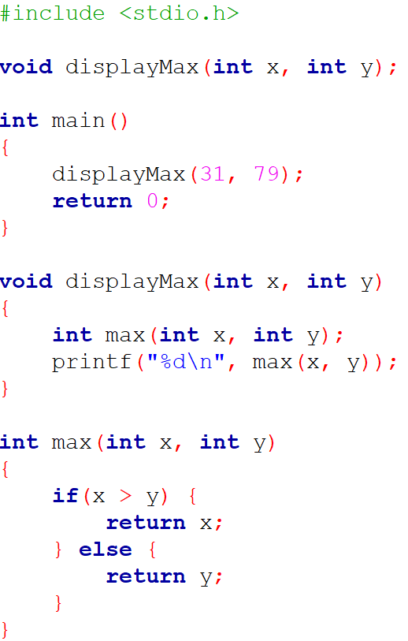
1. Function Declaration
Global or local declaration

Slide 20
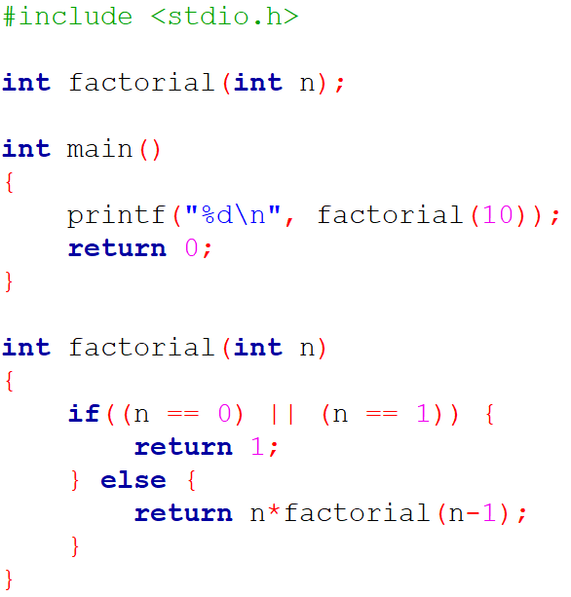

1. Function Declaration
Recursive functions
Recursive functions can be implemented in C; but be careful to include a stop condition

Slide 21

1. Function Declaration
Exercise
You have a double and an integer
Display the result of the first raised to the power of the second
You will use a recursive function

Slide 22

1. Function Declaration
Questions

Slide 23

2. Splitting a Program into Modules

Slide 24
2. Splitting a Program into Modules
Principle
For the moment, our projects have only one “main.c” file
If the volume of a project becomes important, it will be divided into modules
A module will simply be a coherent set of functions, usually around the same theme
This will of course simplify the implementation of the project
Another advantage is the possible reuse of a module from one project in another one

Slide 25
2. Splitting a Program into Modules
.h and .c files
We will of course keep our “main.c”, it will lead the project
Once we have conceptualized an intelligent breakdown, we will create two types of files for each module:
– A header: “.h” file that will contain the function prototypes of the module
– A source file: “.c” file that will contain their implementation

Slide 26
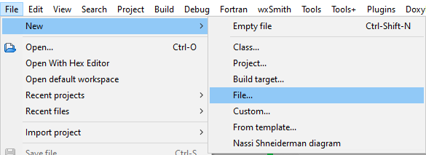
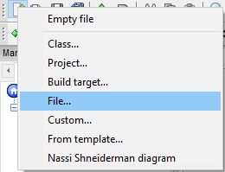
2. Splitting a Program into Modules
.h and .c files
OR

Slide 27
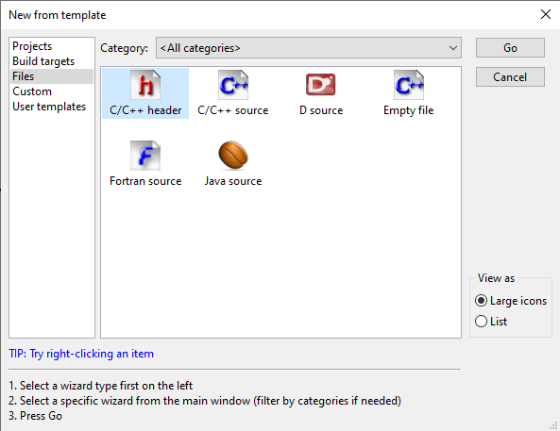
2. Splitting a Program into Modules
.h and .c files
Choose the file type. First, add a “.h” file by selecting C/C++ header

Slide 28
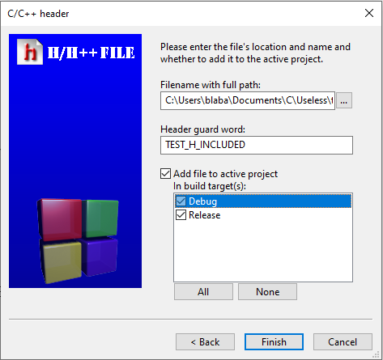
2. Splitting a Program into Modules
.h and .c files
Enter the name and the directory in which you will save this new file, then select the build targets

Slide 29
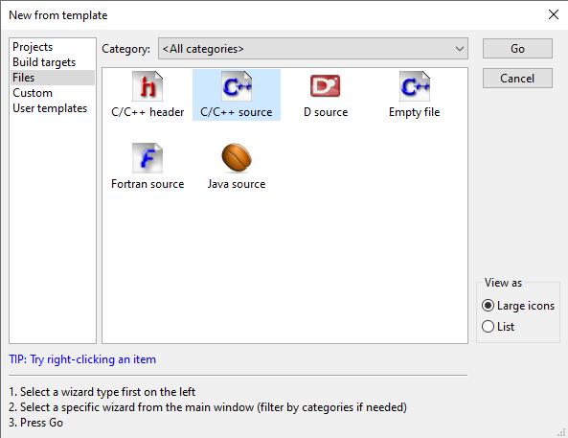
2. Splitting a Program into Modules
.h and .c files
Second, add a “.c” file by selecting C/C++ source

Slide 30
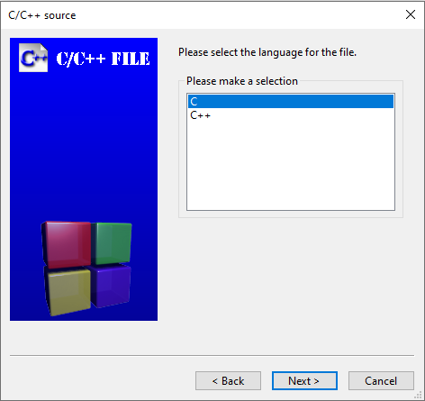
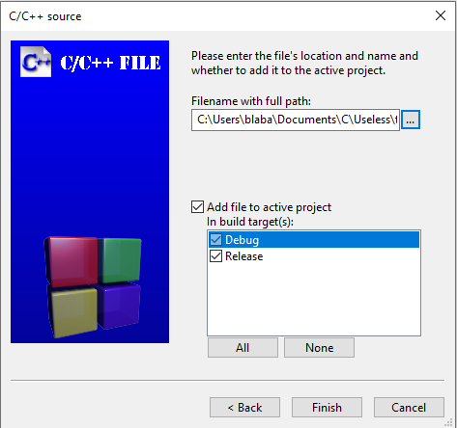
2. Splitting a Program into Modules
.h and .c files
Same process, put an identical file name

Slide 31
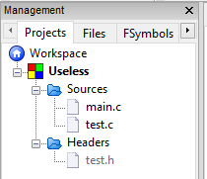
2. Splitting a Program into Modules
.h and .c files
We now have two more files in our project and a new tree structure:

Slide 32

2. Splitting a Program into Modules
.h and .c files
In order to use the functions that we are going to define in the test module, we need to include the “test.h” file into the main:
This inclusion is not done with the same delimiters as the standard libraries

Slide 33
2. Splitting a Program into Modules
.h and .c files
If our project contains several modules, it may happen that the same “.h” file is included in several other files
This implies a risk of multiple declarations of functions in this file, and therefore of errors during compilation
To avoid this phenomenon, it is thus necessary to set up a protection mechanism allowing to check if a “.h” file has already been included (thus if the declarations are already present in memory)

Slide 34
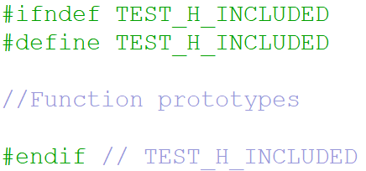
2. Splitting a Program into Modules
.h and .c files
“.h” content:

Slide 35
2. Splitting a Program into Modules
.h and .c files
#ifndef TEST_H_INCLUDED checks if the constant TEST_H_INCLUDED has already been defined:
– If it is not the case, we define it with #define TEST_H_INCLUDED then we load in memory the declarations of the functions contained in the file
– If this is the case, it means that the file has already been included and that the function declarations are already in memory; we then go directly to #endif which indicates the end of the file

Slide 36
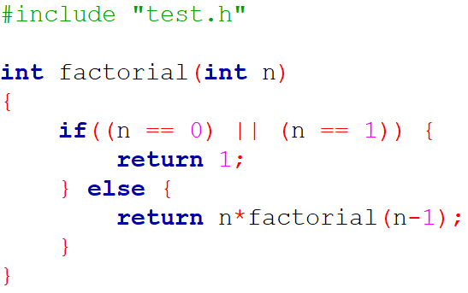
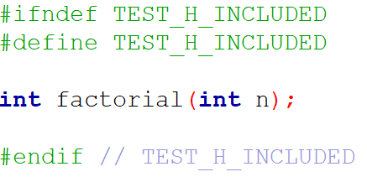
2. Splitting a Program into Modules
Example
test.c
test.h

Slide 37
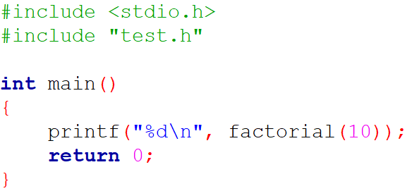
2. Splitting a Program into Modules
Example
main.c

Slide 38
2. Splitting a Program into Modules
Questions

Slide 39

3. Function Parameters

Slide 40
3. Function Parameters
Passing arguments by value
When we send an argument to a function, a local variable is automatically created to store the value of this parameter
The function then works on this copy and not on the original
If we pass a variable to a function, it will be able to modify the value of the local copy but not the original one

Slide 41
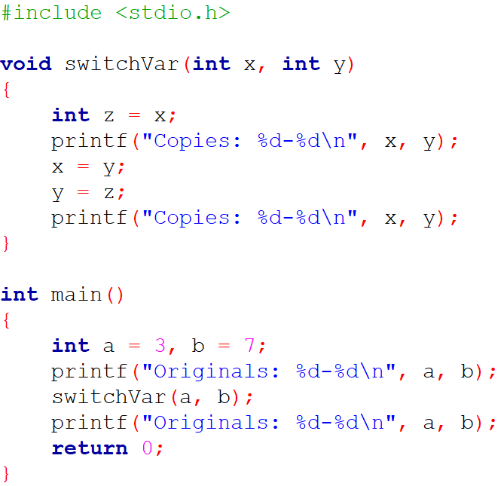
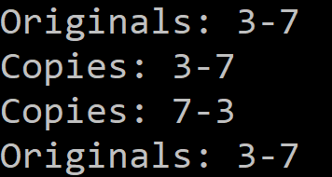
3. Function Parameters
Passing arguments by value

Slide 42
3. Function Parameters
Passing arguments by pointer
If we want a function to modify the value of a variable passed in argument, we must not transmit to the function the value of the variable but its address
The function will then work with a copy of the address of the variable, and can thus modify its value

Slide 43
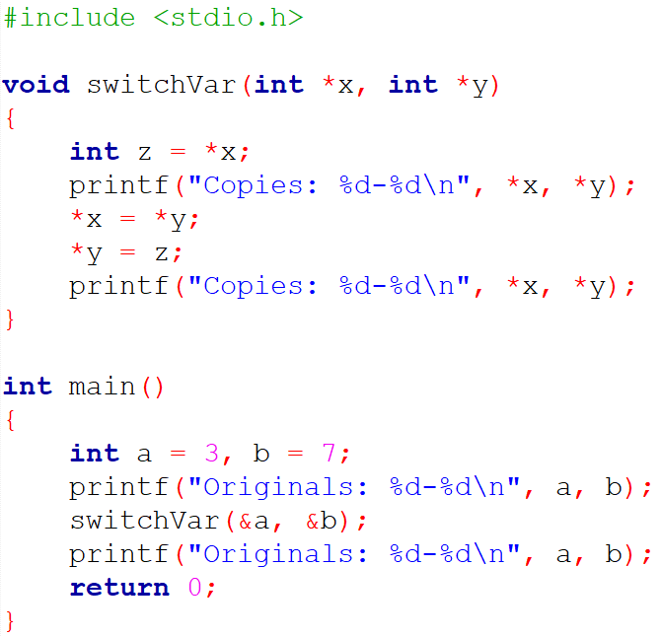
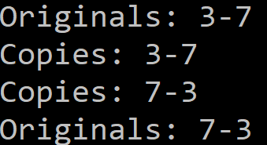
3. Function Parameters
Passing arguments by pointer

Slide 44
3. Function Parameters
Arrays as parameters
Using type *tab; or type tab[];, you must pass the size of the array as an argument
It is therefore a question of passing arguments by pointer, and we can thus make modifications to this array

Slide 45
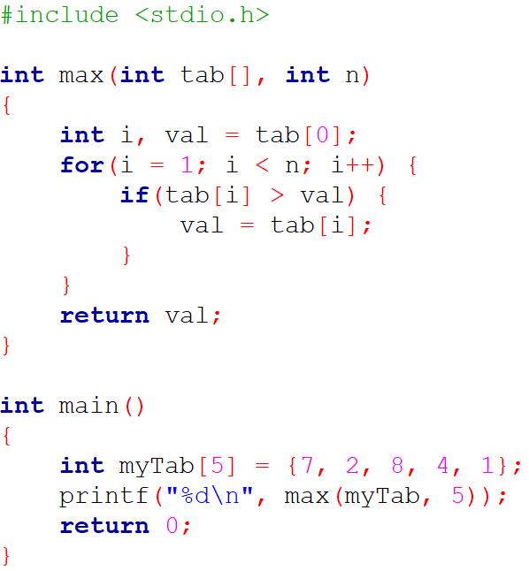

3. Function Parameters
Arrays as parameters
Notes:
Or int *tab

Slide 46

3. Function Parameters
Structures as parameters
No change compared to the passage of a variable of an elementary type
The passage can be done by value or by pointer

Slide 47
3. Function Parameters
Exercise
Write a function taking as parameters three real variables x, y, z
Realize the circular permutation of these three variables: at the end of the function, x will contain the initial value of z, y will contain the initial value of x and z the initial value of y
This function will not return any value

Slide 48
3. Function Parameters
Questions

Slide 49

C Developer
Functions
Thank you for your attention

